Slide 1
Mapping

Slide 2
Module Overview
In this Module, we will understand the following:
What is Mapping
Persistent Class
Mapping Files
Mapping Types
OIR Mappings

Slide 3
Mapping
In case of hibernate mapping associations, 1 & only 1 of the participating classes is called as managing the relationship.
Another is called managed by using ‘mappedBy’ property.
Java objects can be identifies by hibernate as persistent when annotated with specific annotations; or else they are identified as simple plain java objects with no direct relation to database.
The JPA annotations & persistent entities when used, can lead to a situation where 2 entities can be related & should be referenced from one another, in uni-direction or in bi-direction.
Entities can be referenced to each other, directly or indirectly using an embedded property or using a collection of arrays, sets, lists, etc.
foreign key relationships are used for associations.
The association is unidirectional if only 1 of the entity pair contains a reference to another.
In case of Mutual association it is bidirectional.

Slide 4
Persistent Class
These are java classes whose objects are stored in database. These classes are known as the Plain Old Java Object (POJO) programming model if they follow rules.
They implement the entities of the business problem (e.g. Customer and Order in an E-commerce application). Not all instances of a persistent class are in the persistent state.
- Instead of being transient, an instance can be detached also
values from Java class attributes is taken and then stored to a database. Hibernate determines using mapping table on how to retrieve the classes values & do necessary mapping to tables & fields.
Notes:
@Entity:
Contained persistent package. It provide at least one no argumented Constructor.
Syntax:
@Entity public class Employee implements Serializable { }
@Table
Details of employee or student that persist database. Use the schema and enforce constraints of column.
Syntax:
@Table(name = "employee")
@Column
Name attribute of this annotation is used for specifying the table’s column name.
Syntax:
@Column(name = "employee_name")
@Id
specifies the primary key of the entity.
Syntax:
@Id
@Column(name = "id")
@Transient
Syntax:
@Transient
Private int employeePhone;

Slide 5
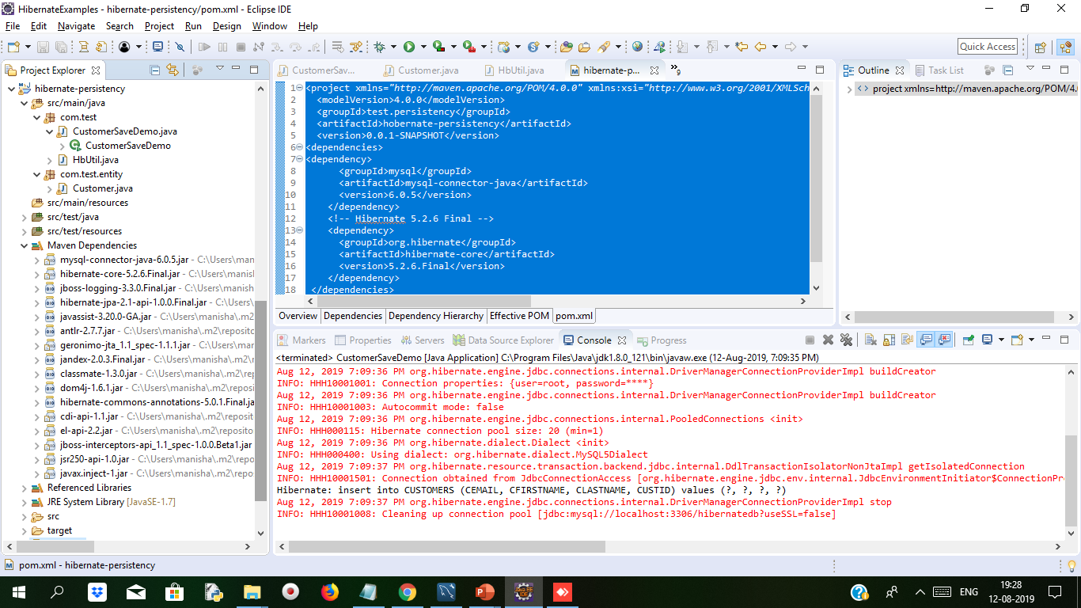
Demo: Persistent Cont..
Create Maven Project . The structure is as below
In this example we will create Customer.java class whose object will store in the database table
We created com.test package which has CustomerSaveDemo.java file and HbUtil.java file and com.test.entity package will have Customer.java file

Slide 6
Demo: Persistent Cont..
Adding dependency to project in Pom.xml
<project xmlns="http://maven.apache.org/POM/4.0.0" xmlns:xsi="http://www.w3.org/2001/XMLSchema-instance" xsi:schemaLocation="http://maven.apache.org/POM/4.0.0 http://maven.apache.org/xsd/maven-4.0.0.xsd">
<modelVersion>4.0.0</modelVersion>
<groupId>test.persistency</groupId>
<artifactId>hobernate-persistency</artifactId>
<version>0.0.1-SNAPSHOT</version>
<dependencies>
<dependency>
<groupId>mysql</groupId>
<artifactId>mysql-connector-java</artifactId>
<version>6.0.5</version>
</dependency>
<!-- Hibernate 5.2.6 Final -->
<dependency>
<groupId>org.hibernate</groupId>
<artifactId>hibernate-core</artifactId>
<version>5.2.6.Final</version>
</dependency>
</dependencies>
</project>

Slide 7
Demo: Persistent Cont..
Customer.java Persistence Class
package com.test.entity;
import java.util.Date;
import javax.persistence.Column;
import javax.persistence.Entity;
import javax.persistence.Id;
import javax.persistence.Table;
@Entity
@Table(name="CUSTOMERS")
public class Customer {
@Id
@Column(name="CUSTID")
private int id;
@Column(name="CFIRSTNAME")
private String firstName;
@Column(name="CLASTNAME")
private String lastName;
@Column(name="CEMAIL")
private String email;
public void setId(int id) {
this.id = id;
}
public int getId() {
return id;
}
public void setFirstName(String firstName) {
this.firstName = firstName;
}
public String getFirstName() {
return firstName;
}
public void setLastName(String lastName) {
this.lastName = lastName;
}
public String getLastName() {
return lastName;
}
public void setEmail(String email)
{
this.email=email;
}
public String getEmail() {
return email;
}
}

Slide 8
Demo: Persistent Cont..
settings.put("hibernate.dialect","org.hibernate.dialect.MySQL5Dialect");
registryBuilder.applySettings(settings);
registry = registryBuilder.build();
MetadataSources sources = new MetadataSources(registry)
.addAnnotatedClass(Customer.class);
Metadata metadata = sources.getMetadataBuilder().build();
sessionFactory = metadata.getSessionFactoryBuilder().build();
} catch (Exception e) {
System.out.println("SessionFactory creation failed");
if (registry != null) {
StandardServiceRegistryBuilder.destroy(registry);
}
}
}
return sessionFactory;
}
public static void shutdown() {
if (registry != null) {
StandardServiceRegistryBuilder.destroy(registry);
}
}
}
HbUtil.java file for configuring database connection
package com.test;
import java.util.HashMap;
import java.util.Map;
import org.hibernate.SessionFactory;
import org.hibernate.boot.Metadata;
import org.hibernate.boot.MetadataSources;
import org.hibernate.boot.registry.StandardServiceRegistry;
import org.hibernate.boot.registry.StandardServiceRegistryBuilder;
import com.test.entity.Customer;
public class HbUtil {
private static StandardServiceRegistry registry;
private static SessionFactory sessionFactory;
public static SessionFactory getSessionFactory() {
if (sessionFactory == null) {
try {
StandardServiceRegistryBuilder registryBuilder =
new StandardServiceRegistryBuilder();
Map<String, String> settings = new HashMap<>();
settings.put("hibernate.connection.driver_class", "com.mysql.cj.jdbc.Driver");
settings.put("hibernate.connection.url", "jdbc:mysql://localhost:3306/hibernatedb?useSSL=false");
settings.put("hibernate.connection.username", "root");
settings.put("hibernate.connection.password", "root");
settings.put("hibernate.show_sql", "true");
settings.put("hibernate.hbm2ddl.auto", "update");

Slide 9
Demo: Persistent Cont..
CustomerSaveDemo.java file for starting the transaction through persistence class customer
package com.test;
import java.util.Calendar;
import org.hibernate.Session;
import org.hibernate.Transaction;
import com.test.entity.Customer;
public class CustomerSaveDemo {
public static void main(String[] args) {
// TODO Auto-generated method stub
Session session = null;
Transaction transaction = null;
try {
session = HbUtil.getSessionFactory().openSession();
transaction=session.getTransaction();
if(!transaction.isActive())
transaction.begin();
Customer customer = new Customer();
customer.setId(17);
customer.setFirstName("Nisha");
customer.setLastName("Rastogi");
customer.setEmail("rNisha@gmail.com");
session.save(customer);
transaction.commit();
} catch (Exception e) {
if (transaction != null) {
transaction.rollback();
}
e.printStackTrace();
} finally {
if (session != null) {
session.close();
}
}
HbUtil.shutdown();
}
}

Slide 10
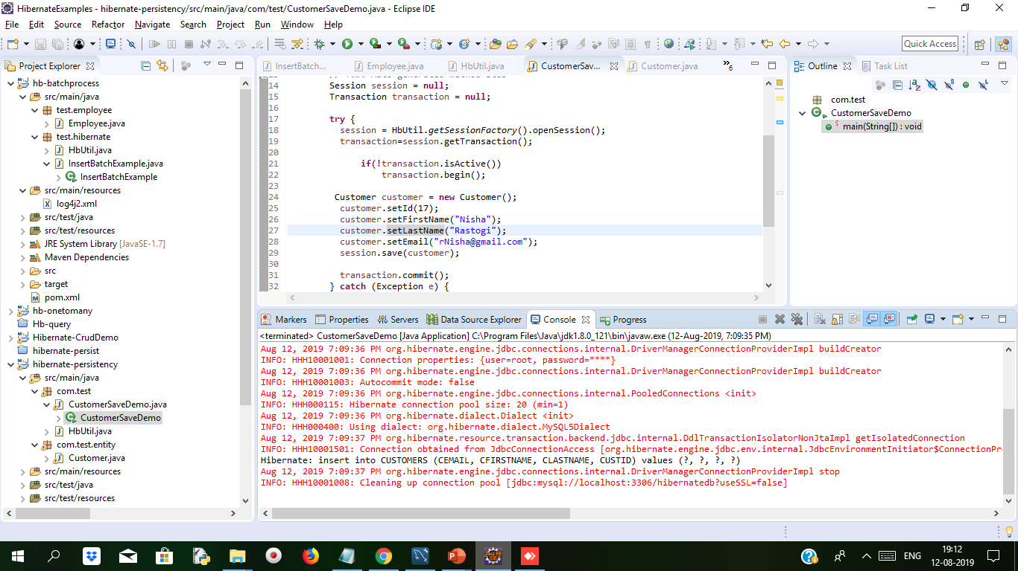
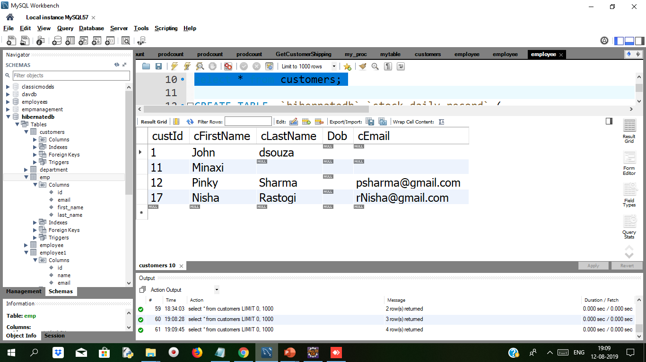
Demo: Persistent Cont..
After running the CustomerSaveDemo we get following output
Open mysql workbench we get values inserted in the customer table

Slide 11
Mapping Files
Mapping and Configuration are very familiar keywords we used to here in the hibernate, every hibernate program must need these 2 xml files.
Object/relational mappings are usually defined in an XML document. The mapping document is designed to be readable and hand-editable. The mapping language is Java-centric, meaning that mappings are constructed around persistent class declarations and not table declarations.
Primary key Auto - Generation in
Generating Primary Key automatically.
Example
If You have database table name of Student Which has two Column
Roll_No
Name
Now In This table we have define Roll_No As Primary key
There is two Ways To Define Primary Key
Define Values of All Field
Only Give Name And Primary Key Generated Automatically.
In Hibernate Prove Unique Number called Primary Key.
Notes:
Refer: https://docs.jboss.org/hibernate/core/3.3/reference/en/html/mapping.html

Slide 12
Mapping Files Cont..
How To Generate Primary Key Value
Hibernate Generate Automatically value of primary key.
For Automatically primary key Hibernate used @GeneratedValue Annotation.
Syntax:
@Id @GeneratedValue(Strategy = GenerationType.AUTO)
Private int rollNo;
Strategy For GeneratedValue Annotation:
AUTO
IDENTITY
SEQUENCE
TABLE
Notes:
@GeneratedValue defines how to generate value for the given column. GenerationType.AUTO sets @GeneratedValue automatic.
If table has defined any default value or it has defined any auto increment in table then in that case we use
@GeneratedValue(strategy=GenerationType.AUTO)

Slide 13
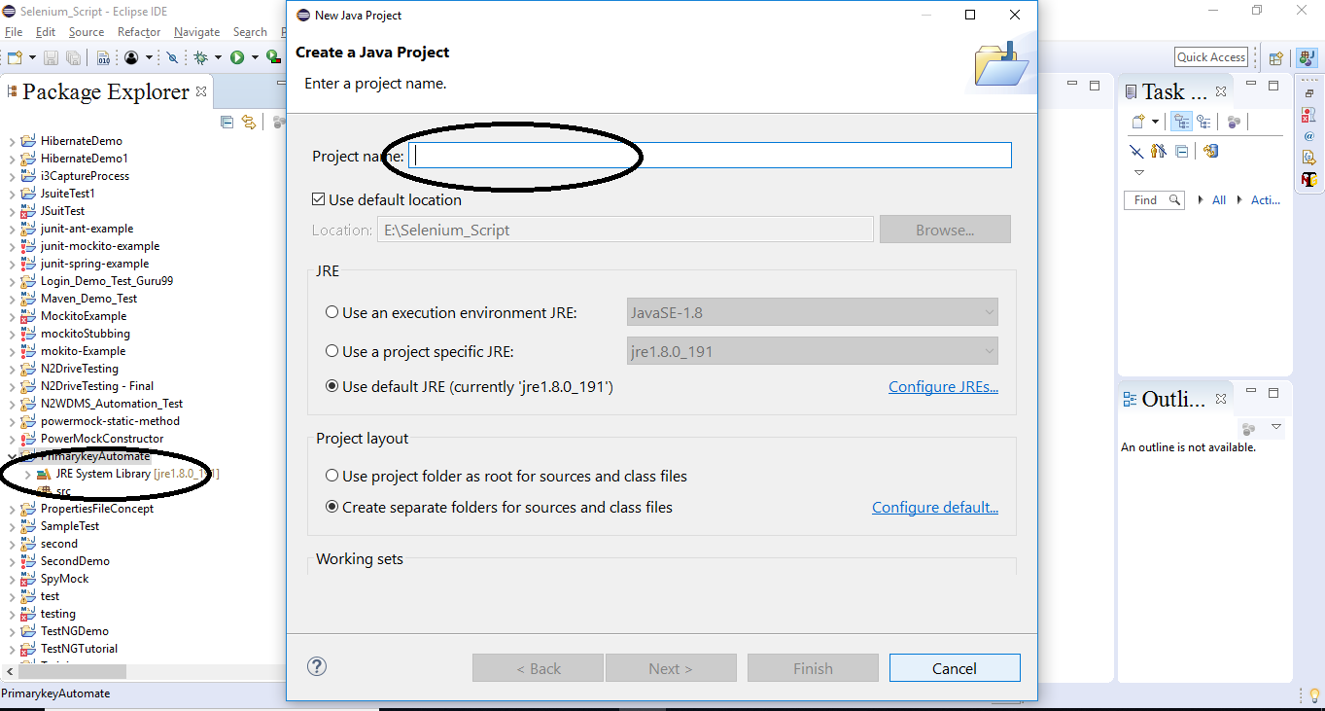
Demo: Mapping File Duration 10 min
Step 1: Example
Create New Java Maven Project and Give Artificial Id and Group Id

Slide 14
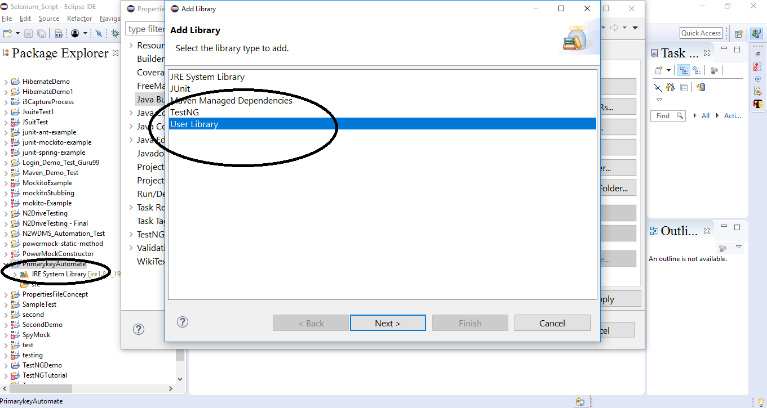
Demo: Mapping File Cont..
Step 2:
Add User Library

Slide 15
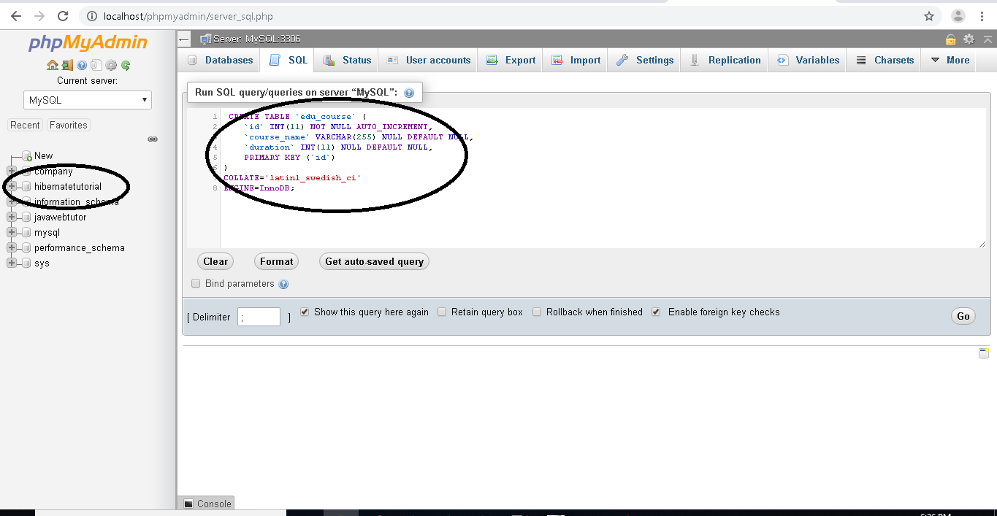
Demo: Mapping File Cont..
Step 3:
Create Database and table

Slide 16
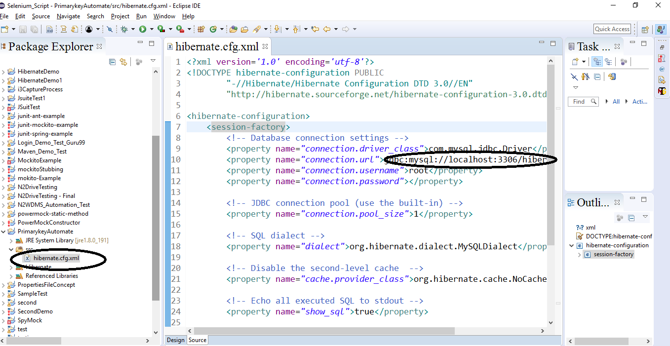
Demo: Mapping File Cont..
Step 4:
Configure hbm.config.xml file with new database name

Slide 17
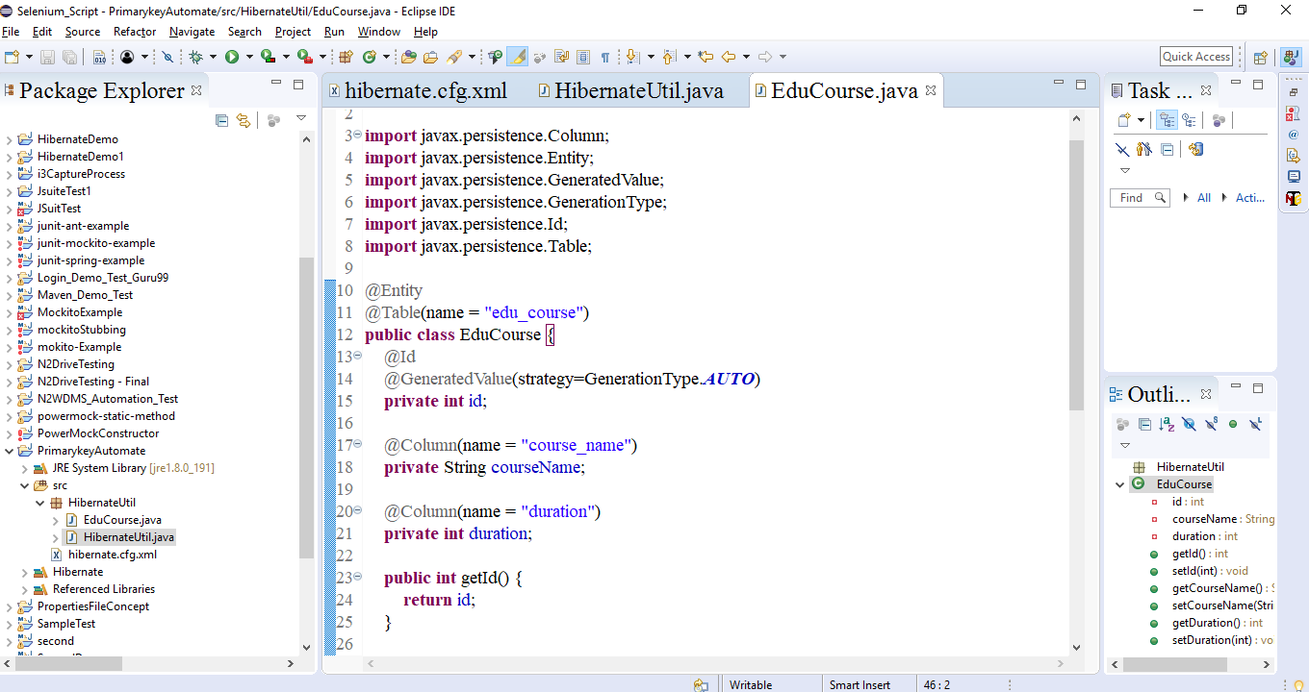
Demo: Mapping File Cont..
Step 5:
Using Annotations create pojo

Slide 18
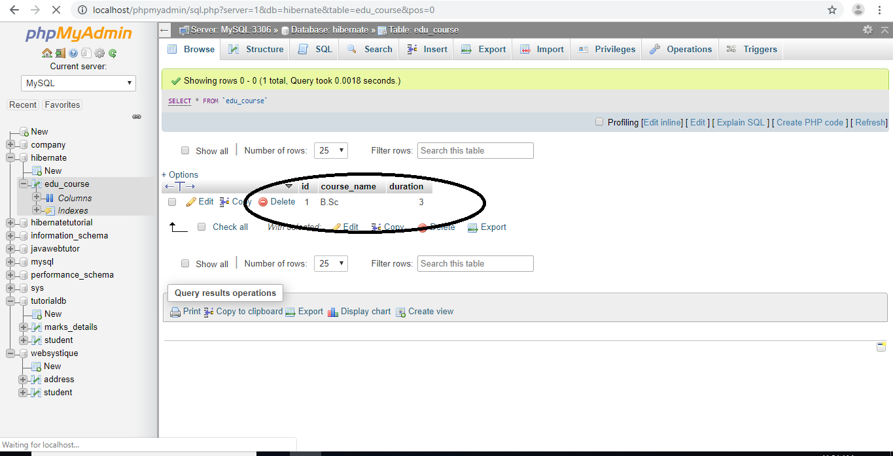
Demo: Mapping File Cont..
Step 6:
Output

Slide 19
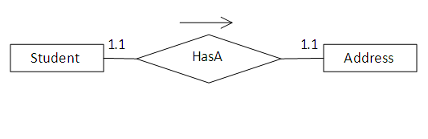
One to One Mapping using Annotations
Mapping Types
Database Table Associated many forms:
One-to-one
One-to-many
Many-to-many
This Association divided in XML Configuration and Annotation.
Example
Notes:
According to the relationship each student should have a unique address.
To create this relationship you need to have a STUDENT and ADDRESS table. The relational model is shown below.
Syntax:
@OneToOne
@PrimaryKeyJoinColumn
private Customer customer;
public CustomerDetails() {
}

Slide 20
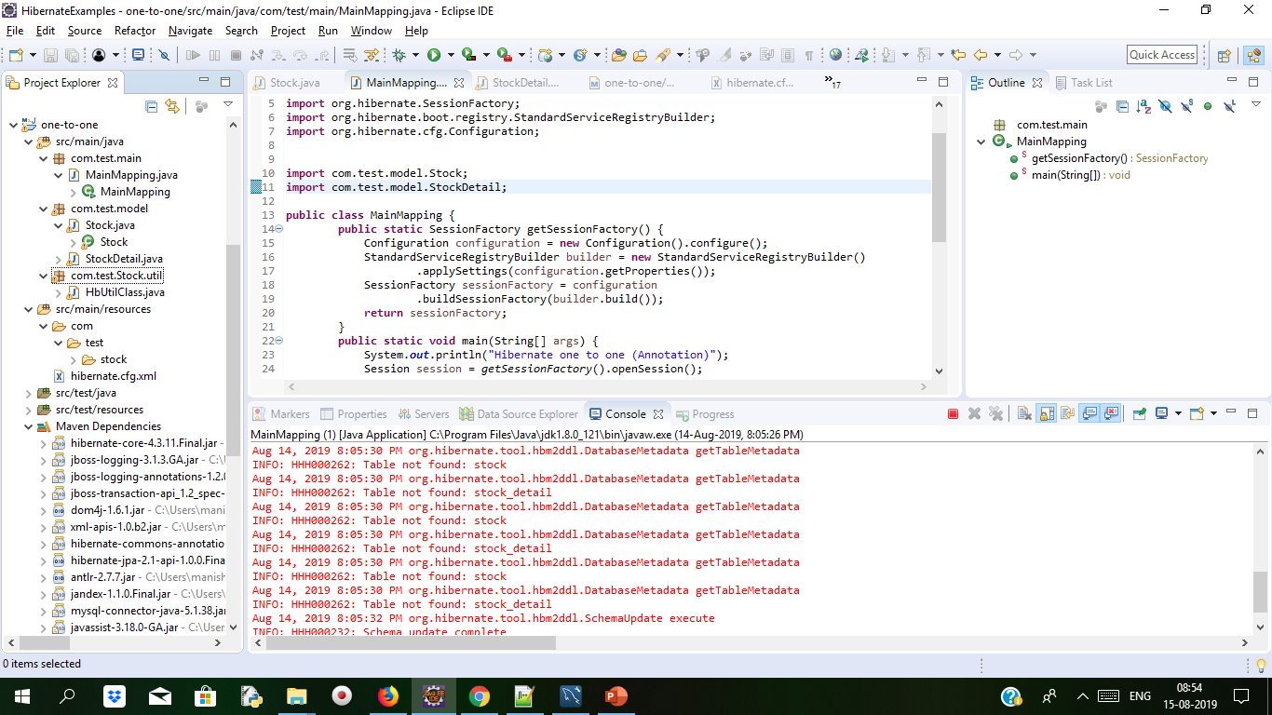
Demo: Mapping Types One to One Cont..
Create Maven Project the project structure is as below
Pom.xml
<project xmlns="http://maven.apache.org/POM/4.0.0" xmlns:xsi="http://www.w3.org/2001/XMLSchema-instance" xsi:schemaLocation="http://maven.apache.org/POM/4.0.0 http://maven.apache.org/xsd/maven-4.0.0.xsd">
<modelVersion>4.0.0</modelVersion>
<groupId>OnetoManyMap</groupId>
<artifactId>hb-onetomany</artifactId>
<version>0.0.1-SNAPSHOT</version>
<dependencies>
<dependency>
<groupId>org.hibernate</groupId>
<artifactId>hibernate-core</artifactId>
<version>4.3.11.Final</version>
</dependency>
<dependency>
<groupId>mysql</groupId>
<artifactId>mysql-connector-java</artifactId>
<version>5.1.38</version>
</dependency>
<dependency>
<groupId>org.javassist</groupId>
<artifactId>javassist</artifactId>
<version>3.18.0-GA</version>
</dependency>
</dependencies>
</project>

Slide 21
Demo: Mapping Types Cont..
Stock.java file create stock table in database with the entities
package com.test.model;
import javax.persistence.CascadeType;
import javax.persistence.Column;
import javax.persistence.Entity;
import javax.persistence.FetchType;
import javax.persistence.GeneratedValue;
import static javax.persistence.GenerationType.IDENTITY;
import javax.persistence.Id;
import javax.persistence.OneToOne;
import javax.persistence.Table;
import javax.persistence.UniqueConstraint;
@Entity
@Table(name = "stock", uniqueConstraints = {
@UniqueConstraint(columnNames = "STOCK_NAME"),
@UniqueConstraint(columnNames = "STOCK_CODE") })
public class Stock implements java.io.Serializable {
private Integer stockId;
private String stockCode;
private String stockName;
private StockDetail stockDetail;
public Stock() {
}
public Stock(String stockCode, String stockName) {
this.stockCode = stockCode;
this.stockName = stockName;
}
public Stock(String stockCode, String stockName, StockDetail stockDetail) {
this.stockCode = stockCode;
this.stockName = stockName;
this.stockDetail = stockDetail;
}
@Id
@GeneratedValue(strategy = IDENTITY)
@Column(name = "STOCK_ID", unique = true, nullable = false)
public Integer getStockId() {
return this.stockId;
}
public void setStockId(Integer stockId) {
this.stockId = stockId;
}

Slide 22
Demo: Mapping Types Cont..
@Column(name = "STOCK_CODE", unique = true, nullable = false, length = 10)
public String getStockCode() {
return this.stockCode;
}
public void setStockCode(String stockCode) {
this.stockCode = stockCode;
}
@Column(name = "STOCK_NAME", unique = true, nullable = false, length = 20)
public String getStockName() {
return this.stockName;
}
public void setStockName(String stockName) {
this.stockName = stockName;
}
@OneToOne(fetch = FetchType.LAZY, mappedBy = "stock", cascade = CascadeType.ALL)
public StockDetail getStockDetail() {
return this.stockDetail;
}
public void setStockDetail(StockDetail stockDetail) {
this.stockDetail = stockDetail;
}
}

Slide 23
Demo: Mapping Types Cont..
Stock_detail class for making table entity stock_detail with mapping columns
package com.test.model;
import java.util.Date;
import javax.persistence.Column;
import javax.persistence.Entity;
import javax.persistence.FetchType;
import javax.persistence.GeneratedValue;
import javax.persistence.Id;
import javax.persistence.OneToOne;
import javax.persistence.PrimaryKeyJoinColumn;
import javax.persistence.Table;
import javax.persistence.Temporal;
import javax.persistence.TemporalType;
import org.hibernate.annotations.GenericGenerator;
import org.hibernate.annotations.Parameter;
@Entity
@Table(name = "stock_detail")
public class StockDetail implements java.io.Serializable {
private Integer stockId;
private Stock stock;
private String compName;
private String compDesc;
private String remark;
private Date listedDate;

Slide 24
Demo: Mapping Types Cont..
public StockDetail() {
}
public StockDetail(Stock stock, String compName, String compDesc,
String remark, Date listedDate) {
this.stock = stock;
this.compName = compName;
this.compDesc = compDesc;
this.remark = remark;
this.listedDate = listedDate;
}
@GenericGenerator(name = "generator", strategy = "foreign",
parameters = @Parameter(name = "property", value = "stock"))
@Id
@GeneratedValue(generator = "generator")
@Column(name = "STOCK_ID", unique = true, nullable = false)
public Integer getStockId() {
return this.stockId; One to one mapping
}
public void setStockId(Integer stockId) {
this.stockId = stockId;
}
@OneToOne(fetch = FetchType.LAZY)
@PrimaryKeyJoinColumn
public Stock getStock() {
return this.stock;
}

Slide 25
Demo: Mapping Types Cont..
public void setStock(Stock stock) {
this.stock = stock;
}
@Column(name = "COMP_NAME", nullable = false, length = 100)
public String getCompName() {
return this.compName;
}
public void setCompName(String compName) {
this.compName = compName;
}
@Column(name = "COMP_DESC", nullable = false)
public String getCompDesc() {
return this.compDesc;
}
public void setCompDesc(String compDesc) {
this.compDesc = compDesc;
}
@Column(name = "REMARK", nullable = false)
public String getRemark() {
return this.remark;
}

Slide 26
Demo: Mapping Types Cont..
public void setRemark(String remark) {
this.remark = remark;
}
@Temporal(TemporalType.DATE)
@Column(name = "LISTED_DATE", nullable = false, length = 10)
public Date getListedDate() {
return this.listedDate;
}
public void setListedDate(Date listedDate) {
this.listedDate = listedDate;
}
}

Slide 27
Demo: Mapping Types Cont..
package com.test.main;
import java.util.Date;
import org.hibernate.Session;
import org.hibernate.SessionFactory;
import org.hibernate.boot.registry.StandardServiceRegistryBuilder;
import org.hibernate.cfg.Configuration;
import com.test.model.Stock;
import com.test.model.StockDetail;
public class MainMapping {
public static SessionFactory getSessionFactory() {
Configuration configuration = new Configuration().configure();
StandardServiceRegistryBuilder builder = new StandardServiceRegistryBuilder()
.applySettings(configuration.getProperties());
SessionFactory sessionFactory = configuration
.buildSessionFactory(builder.build());
return sessionFactory;
}
public static void main(String[] args) {
System.out.println("Hibernate one to one (Annotation)");
Session session = getSessionFactory().openSession();

Slide 28
Demo: Mapping Types Cont..
session.beginTransaction();
Stock stock = new Stock();
stock.setStockCode("10001");
stock.setStockName("Agent");
StockDetail stockDetail = new StockDetail();
stockDetail.setCompName("Reynold");
stockDetail.setCompDesc("Iso");
stockDetail.setRemark("Good");
stockDetail.setListedDate(new Date());
stock.setStockDetail(stockDetail);
stockDetail.setStock(stock);
session.save(stock);
session.getTransaction().commit();
System.out.println("Inserting values into tables stock,stock details....");
System.out.println("Done");
}
}

Slide 29
Demo: Mapping Types Cont..
Hibernate.cfg.xml database connection configurations and mapping class mentioned in xml
<?xml version='1.0' encoding='UTF-8'?>
<!DOCTYPE hibernate-configuration PUBLIC
"-//Hibernate/Hibernate Configuration DTD 3.0//EN"
"http://www.hibernate.org/dtd/hibernate-configuration-3.0.dtd">
<hibernate-configuration>
<session-factory>
<property name="hibernate.dialect">org.hibernate.dialect.MySQLDialect</property>
<property name="hibernate.connection.driver_class">com.mysql.jdbc.Driver</property>
<property name="hibernate.connection.url">jdbc:mysql://localhost/test</property>
<property name="hibernate.connection.username">root</property>
<property name="hibernate.connection.password">root</property>
<property name="hibernate.hbm2ddl.auto">update</property>
<property name="show_sql">false</property>
<property name="hibernate.current_session_context_class">org.hibernate.context.internal.ThreadLocalSessionContext</property>
<mapping class="com.test.model.Stock"/>
<mapping class="com.test.model.StockDetail"/>
</session-factory>
</hibernate-configuration>

Slide 30
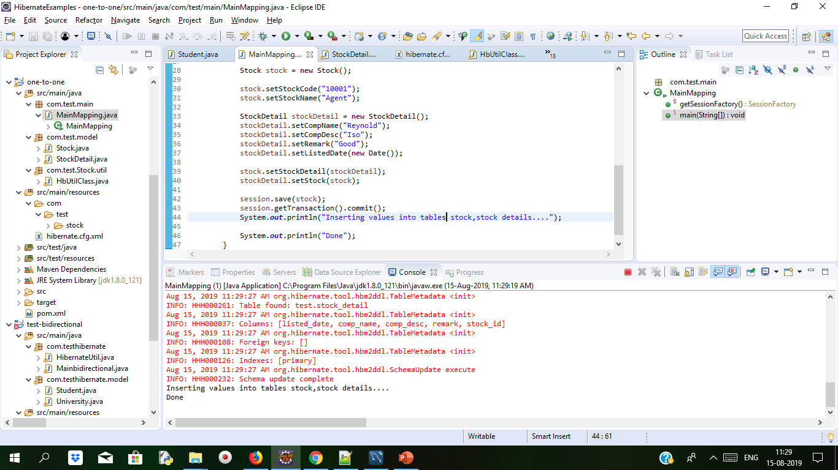
Demo: Mapping Types Cont..
After running MainMapping.java output will be as follows.

Slide 31
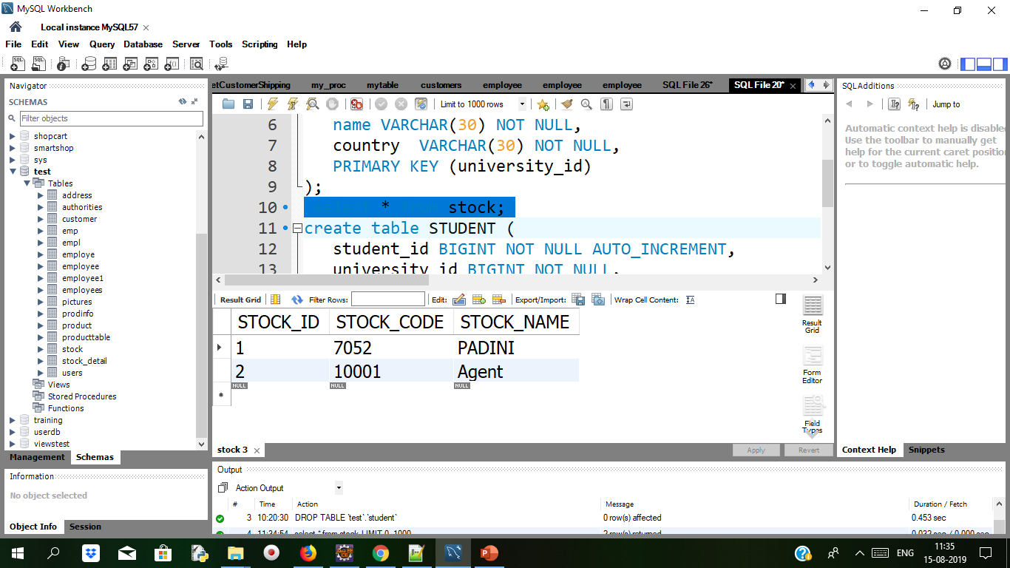
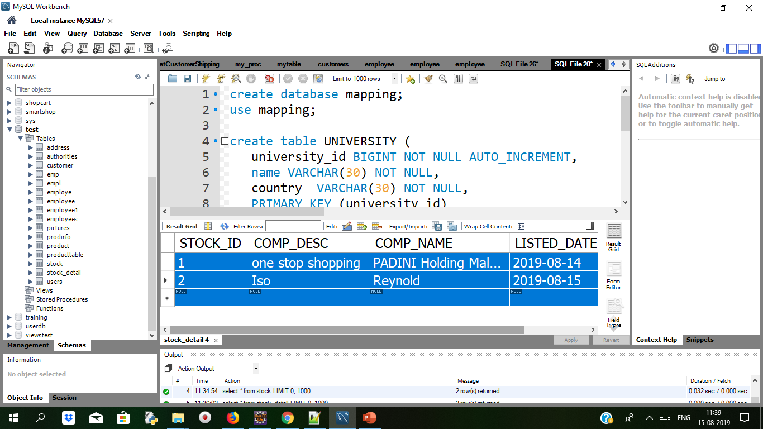
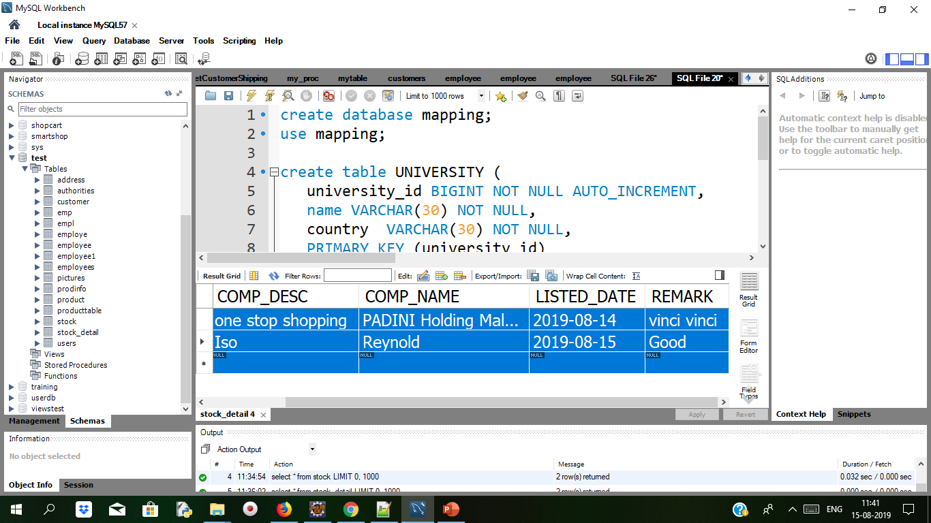
Demo: Mapping Types Cont..
Database record in stock and stock_detail table
A one-to-one relationships happens when one entity is relating exactly one occurrence in another entity. In this Example, we saw how to work with one-to-one table relationship in Hibernate, via XML mappingfile. Tools

Slide 32
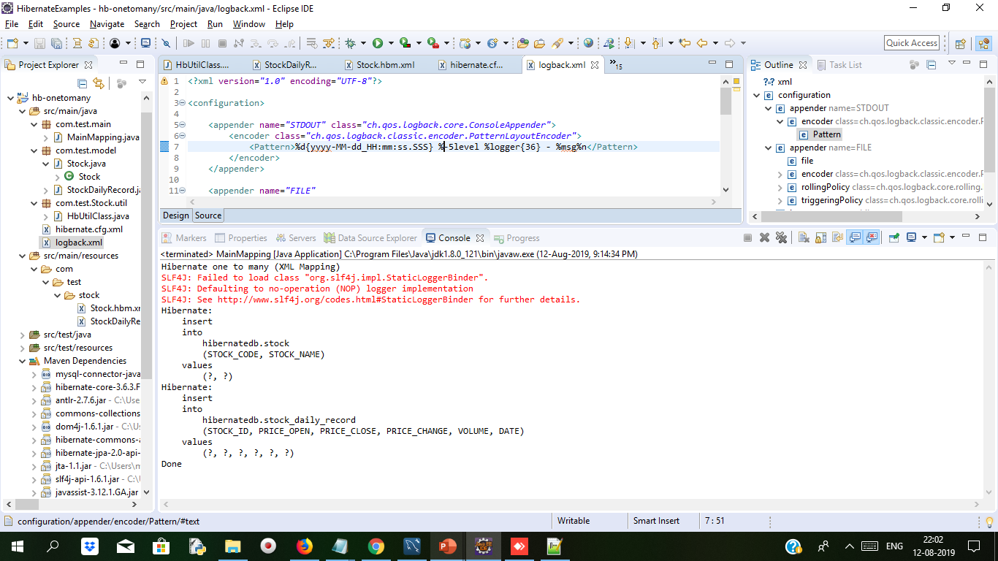
Bidrectional One to Many and many to one Mapping Example Duration 15 min
Create maven Project

Slide 33
Bidrectional One to Many and many to one Mapping Example Duration 15 min
Open mysql workbench and type below script in query tab for creating tables
CREATE TABLE `hibernatedb`.`stock_daily_record` (
`RECORD_ID` int(10) unsigned NOT NULL AUTO_INCREMENT,
`PRICE_OPEN` float(6,2) DEFAULT NULL,
`PRICE_CLOSE` float(6,2) DEFAULT NULL,
`PRICE_CHANGE` float(6,2) DEFAULT NULL,
`VOLUME` bigint(20) unsigned DEFAULT NULL,
`DATE` date NOT NULL,
`STOCK_ID` int(10) unsigned NOT NULL,
PRIMARY KEY (`RECORD_ID`) USING BTREE,
UNIQUE KEY `UNI_STOCK_DAILY_DATE` (`DATE`),
KEY `FK_STOCK_TRANSACTION_STOCK_ID` (`STOCK_ID`),
CONSTRAINT `FK_STOCK_TRANSACTION_STOCK_ID` FOREIGN KEY (`STOCK_ID`)
REFERENCES `stock` (`STOCK_ID`) ON DELETE CASCADE ON UPDATE CASCADE
) ENGINE=InnoDB AUTO_INCREMENT=36 DEFAULT CHARSET=utf8;

Slide 34
Bidrectional One to Many and many to one Mapping Example Duration 15 min
create stock table
CREATE TABLE `stock` (
`STOCK_ID` int(10) unsigned NOT NULL AUTO_INCREMENT,
`STOCK_CODE` varchar(10) NOT NULL,
`STOCK_NAME` varchar(20) NOT NULL,
PRIMARY KEY (`STOCK_ID`) USING BTREE,
UNIQUE KEY `UNI_STOCK_NAME` (`STOCK_NAME`),
UNIQUE KEY `UNI_STOCK_ID` (`STOCK_CODE`) USING BTREE
) ENGINE=InnoDB AUTO_INCREMENT=34 DEFAULT CHARSET=utf8;

Slide 35
Bidrectional One to Many and many to one Mapping Example Duration 15 min
Add dependency in pom.xml
<project xmlns="http://maven.apache.org/POM/4.0.0" xmlns:xsi="http://www.w3.org/2001/XMLSchema-instance" xsi:schemaLocation="http://maven.apache.org/POM/4.0.0 http://maven.apache.org/xsd/maven-4.0.0.xsd">
<modelVersion>4.0.0</modelVersion>
<groupId>OnetoManyMap</groupId>
<artifactId>hb-onetomany</artifactId>
<version>0.0.1-SNAPSHOT</version>
<repositories>
<repository>
<id>JBoss repository</id>
<url>http://repository.jboss.org/nexus/content/groups/public/</url>
</repository>
</repositories>
<dependencies>
<!-- MySQL database driver -->
<dependency>
<groupId>mysql</groupId>
<artifactId>mysql-connector-java</artifactId>
<version>5.1.15</version>
</dependency>
<dependency>
<groupId>org.hibernate</groupId>
<artifactId>hibernate-core</artifactId>
<version>3.6.3.Final</version>
</dependency>
<dependency>
<groupId>javassist</groupId>
<artifactId>javassist</artifactId>
<version>3.12.1.GA</version>
</dependency>
</dependencies>
</project>

Slide 36
One to Many and many to one Mapping Example Duration 15 min
Hibernate.cfg.xml for database configuration.Both the file i.e. Hibernate.cfg.xml and logback.xml should be keep in src folder
<?xml version="1.0" encoding="utf-8"?>
<!DOCTYPE hibernate-configuration PUBLIC
"-//Hibernate/Hibernate Configuration DTD 3.0//EN"
"http://www.hibernate.org/dtd/hibernate-configuration-3.0.dtd">
<hibernate-configuration>
<session-factory>
<property name="hibernate.connection.driver_class">com.mysql.jdbc.Driver</property>
<property name="hibernate.connection.url">jdbc:mysql://localhost:3306/hibernatedb</property>
<property name="hibernate.connection.username">root</property>
<property name="hibernate.connection.password">root</property>
<property name="hibernate.dialect">org.hibernate.dialect.MySQLDialect</property>
<property name="show_sql">true</property>
<property name="format_sql">true</property>
<mapping resource="com/test/stock/Stock.hbm.xml" />
<mapping resource="com/test/stock/StockDailyRecord.hbm.xml" />
</session-factory>
</hibernate-configuration>

Slide 37
One to Many and many to one Mapping Example Duration 15 min
Logback.xml
<?xml version="1.0" encoding="UTF-8"?>
<configuration>
<appender name="STDOUT" class="ch.qos.logback.core.ConsoleAppender">
<encoder class="ch.qos.logback.classic.encoder.PatternLayoutEncoder">
<Pattern>%d{yyyy-MM-dd_HH:mm:ss.SSS} %-5level %logger{36} - %msg%n</Pattern>
</encoder>
</appender>
<appender name="FILE"
class="ch.qos.logback.core.rolling.RollingFileAppender">
<file>c:/mkyongapp.log</file>
<encoder class="ch.qos.logback.classic.encoder.PatternLayoutEncoder">
<Pattern>%d{yyyy-MM-dd_HH:mm:ss.SSS} [%thread] %-5level %logger{36} - %msg%n</Pattern>
</encoder>
<rollingPolicy class="ch.qos.logback.core.rolling.FixedWindowRollingPolicy">
<MinIndex>1</MinIndex>
<MaxIndex>10</MaxIndex>
</rollingPolicy>
<triggeringPolicy
class="ch.qos.logback.core.rolling.SizeBasedTriggeringPolicy">
<MaxFileSize>2MB</MaxFileSize>
</triggeringPolicy>
</appender>
<logger name="org.hibernate.type" level="WARN" />
<logger name="org.hibernate" level="WARN" />
<root level="INFO">
<!-- <appender-ref ref="FILE" /> -->
<appender-ref ref="STDOUT" />
</root> </configuration>

Slide 38
Cont..
Make a folder com/test/stock under
src/main/resources/ and keep below file Stock.hbm.xml and Stock_daily_record.hbm.xml
<?xml version="1.0"?>
<!DOCTYPE hibernate-mapping PUBLIC "-//Hibernate/Hibernate Mapping DTD 3.0//EN"
"http://hibernate.sourceforge.net/hibernate-mapping-3.0.dtd">
<!-- Generated 26 April 2011 11:37:37 AM by Hibernate Tools 3.4.0.CR1 -->
<hibernate-mapping>
<class name="com.test.model.Stock" table="stock" catalog="hibernatedb">
<id name="stockId" type="java.lang.Integer">
<column name="STOCK_ID" />
<generator class="identity" />
</id>
<property name="stockCode" type="string">
<column name="STOCK_CODE" length="10" not-null="true" unique="true" />
</property>
<property name="stockName" type="string">
<column name="STOCK_NAME" length="20" not-null="true" unique="true" />
</property>
<set name="stockDailyRecords" table="stock_daily_record" inverse="true" lazy="true" fetch="select">
<key>
<column name="STOCK_ID" not-null="true" />
</key>
<one-to-many class="com.test.model.StockDailyRecord" /></set>
</class>
</hibernate-mapping>

Slide 39
Cont..
Stock_daily_record.hbm.xml
<?xml version="1.0"?>
<!DOCTYPE hibernate-mapping PUBLIC "-//Hibernate/Hibernate Mapping DTD 3.0//EN"
"http://hibernate.sourceforge.net/hibernate-mapping-3.0.dtd">
<!-- Generated 26 April 2011 11:37:37 AM by Hibernate Tools 3.4.0.CR1 -->
<hibernate-mapping>
<class name="com.test.model.StockDailyRecord" table="stock_daily_record" catalog="hibernatedb">
<id name="recordId" type="java.lang.Integer">
<column name="RECORD_ID" />
<generator class="identity" />
</id>
<many-to-one name="stock" class="com.test.model.Stock" fetch="select">
<column name="STOCK_ID" not-null="true" />
</many-to-one>
<property name="priceOpen" type="java.lang.Float">
<column name="PRICE_OPEN" precision="6" />
</property>
<property name="priceClose" type="java.lang.Float">
<column name="PRICE_CLOSE" precision="6" />
</property>
<property name="priceChange" type="java.lang.Float">
<column name="PRICE_CHANGE" precision="6" />
</property>
<property name="volume" type="java.lang.Long">
<column name="VOLUME" />
</property>
<property name="date" type="date">
<column name="DATE" length="10" not-null="true" unique="true" />
</property>
</class>
</hibernate-mapping>

Slide 40
Cont..
public Integer getRecordId() {
return this.recordId;
}
public void setRecordId(Integer recordId) {
this.recordId = recordId;
}
public Stock getStock() {
return this.stock;
}
public void setStock(Stock stock) {
this.stock = stock;
}
public Float getPriceOpen() {
return this.priceOpen;
}
public void setPriceOpen(Float priceOpen) {
this.priceOpen = priceOpen;
}
public Float getPriceClose() {
return this.priceClose;
}
public void setPriceClose(Float priceClose) {
this.priceClose = priceClose;
}
contd….
StockDailyRecord.java Persistency class
package com.test.model;
import java.util.Date;
public class StockDailyRecord {
private Integer recordId;
private Stock stock;
private Float priceOpen;
private Float priceClose;
private Float priceChange;
private Long volume;
private Date date;
public StockDailyRecord() {
}
public StockDailyRecord(Stock stock, Date date) {
this.stock = stock;
this.date = date;
}
public StockDailyRecord(Stock stock, Float priceOpen, Float priceClose,
Float priceChange, Long volume, Date date) {
this.stock = stock;
this.priceOpen = priceOpen;
this.priceClose = priceClose;
this.priceChange = priceChange;
this.volume = volume;
this.date = date;
}

Slide 41
Cont..
Stock.java persistence class
package com.test.model;
import java.util.HashSet;
import java.util.Set;
@SuppressWarnings("serial")
public class Stock implements java.io.Serializable {
private Integer stockId;
private String stockCode;
private String stockName;
private Set<StockDailyRecord> stockDailyRecords = new HashSet<StockDailyRecord>(0);
public Stock(String stockCode, String stockName) {
this.stockCode = stockCode;
this.stockName = stockName;
}
public Stock(String stockCode, String stockName,
Set<StockDailyRecord> stockDailyRecords) {
this.stockCode = stockCode;
this.stockName = stockName;
this.stockDailyRecords = stockDailyRecords;
}
public Stock() {
}
public Integer getStockId() {
return this.stockId;
} contd…
public Float getPriceChange() {
return this.priceChange;
}
public void setPriceChange(Float priceChange) {
this.priceChange = priceChange;
}
public Long getVolume() {
return this.volume;
}
public void setVolume(Long volume) {
this.volume = volume;
}
public Date getDate() {
return this.date;
}
public void setDate(Date date) {
this.date = date;
}
}

Slide 42
Cont..
public void setStockId(Integer stockId) {
this.stockId = stockId;
}
public String getStockCode() {
return this.stockCode;
}
public void setStockCode(String stockCode) {
this.stockCode = stockCode;
}
public String getStockName() {
return this.stockName;
}
public void setStockName(String stockName) {
this.stockName = stockName;
}
public Set<StockDailyRecord> getStockDailyRecords() {
return this.stockDailyRecords;
}
public void setStockDailyRecords(Set<StockDailyRecord> stockDailyRecords) {
this.stockDailyRecords = stockDailyRecords;
}
}

Slide 43
Cont..
HbUtilClass.java for making sessionfactory object
package com.test.Stock.util;
import org.hibernate.SessionFactory;
import org.hibernate.cfg.Configuration;
public class HbUtilClass {
private static final SessionFactory sessionFactory = buildSessionFactory();
private static SessionFactory buildSessionFactory() {
try {
// Create the SessionFactory from hibernate.cfg.xml
return new Configuration().configure().buildSessionFactory();
} catch (Throwable ex) {
// Make sure you log the exception, as it might be swallowed
System.err.println("Initial SessionFactory creation failed." + ex);
throw new ExceptionInInitializerError(ex);
}
}
public static SessionFactory getSessionFactory() {
return sessionFactory;
}
public static void shutdown() {
// Close caches and connection pools
getSessionFactory().close();
}
}

Slide 44
Cont..
MainMapping.java file
package com.test.main;
import java.util.Date;
import org.hibernate.Session;
import com.test.Stock.util.HbUtilClass;
import com.test.model.Stock;
import com.test.model.StockDailyRecord;
public class MainMapping {
public static void main(String[] args) {
System.out.println("Hibernate one to many (XML Mapping)");
Session session = HbUtilClass.getSessionFactory().openSession();
session.beginTransaction();
Stock stock = new Stock();
stock.setStockCode("1901");
stock.setStockName("STATIONARY");
session.save(stock);
StockDailyRecord stockDailyRecords = new StockDailyRecord();
stockDailyRecords.setPriceOpen(new Float("1.2"));
stockDailyRecords.setPriceClose(new Float("1.1"));
stockDailyRecords.setPriceChange(new Float("10.0"));
stockDailyRecords.setVolume(3000000L);
stockDailyRecords.setDate(new Date());
stockDailyRecords.setStock(stock);
stock.getStockDailyRecords().add(stockDailyRecords);
session.save(stockDailyRecords);
session.getTransaction().commit();
System.out.println("Done");
}
}

Slide 45
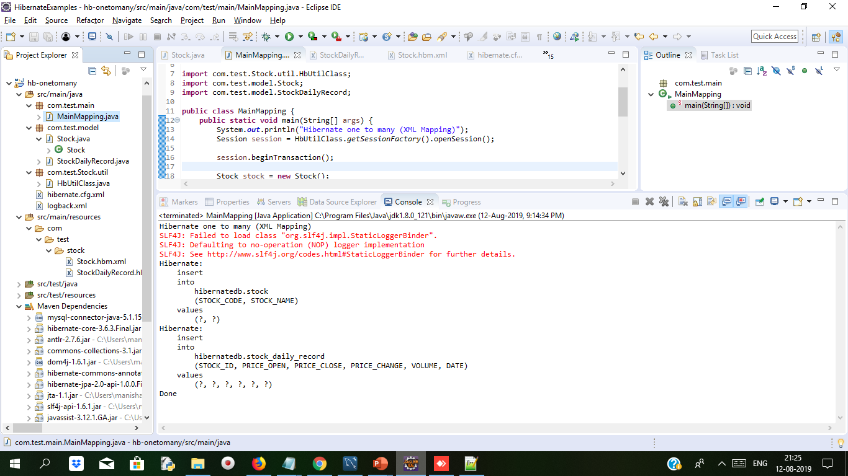
Cont..
Output on Console when we run MainMapping.java file
LogBack.xml file helps to print on console when we execute the main method.It has some pattern for displaying on console

Slide 46
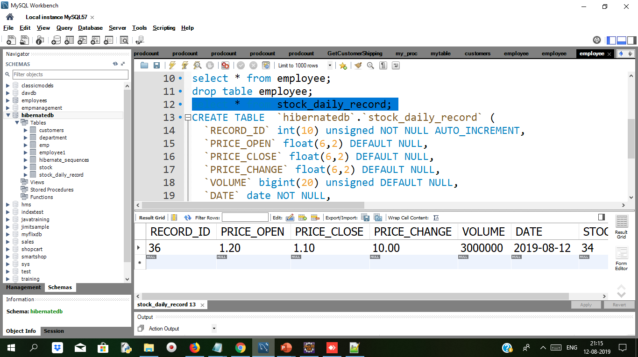
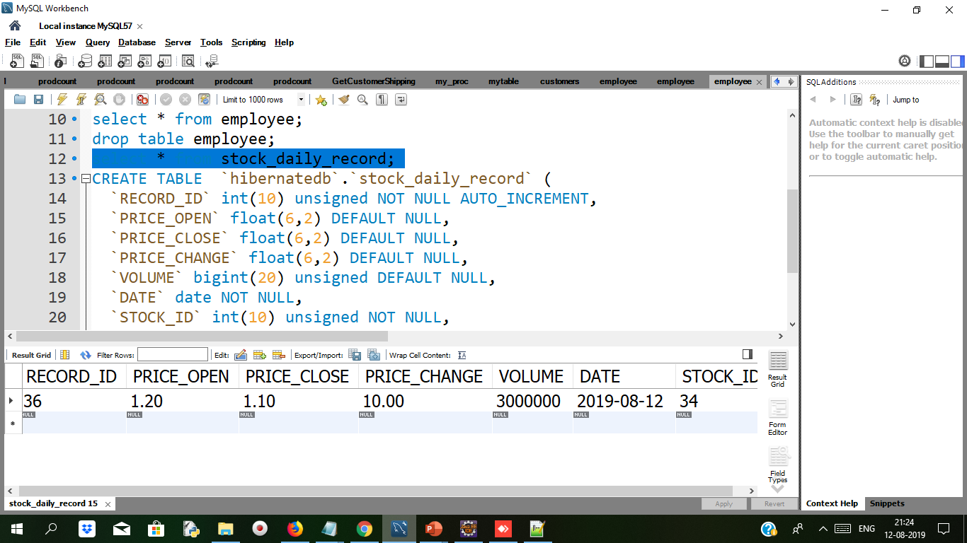
Cont..
When we run MainMapping.java file we get some rows added in Stock table and Stock_daily_record table we can check in mysql workbench with select * from Stock and select * from Stock_daily_record

Slide 47
Unidirectional VS Bidirectional
Unidirectional VS Bidirectional
When only one of the pair of entities contains a reference to the other, the association is unidirectional. | if the association between both entities are mutual, then it is known as bidirectional mapping. in bidirectional mapping
unidirectional mapping from lecturer to course class Lecturer{ private Long id; private String lecturerName; private Course; //getter and setters } class Course{ private Long id; private String courseName; //getter and setters } | The Bidirectional association: class Lecturer{ private Long id; private String lecturerName; private Course; //getter and setters } class Course{ private Long id; private String courseName; private Lecturer lecturer; //getter and setters }

Slide 48
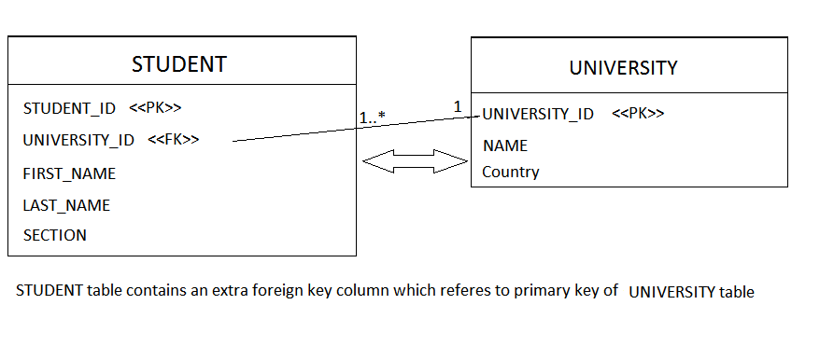
Many to One Mapping in a Hibernate Application
Many to one the relation is from child to parent object.
Many to one relation links to the two-table using foreign key.
@manytoone annotation allows mapping of Child has an entity of parent object.
Syntax:
Public class student{
//…
@oneToMany(mappedBy=“University”)
Private Set<Student_Id> ;
//…
}

Slide 49
Many to One Mapping in a Hibernate Application Cont..
-Each entity has relationship with each other
-Entity constraint Foreign key
-Also used Mapped By Property
-One table provide foreign key which give reference to another table.
Syntax:
@Entity
public class Review {
@Id
@GeneratedValue(strategy = GenerationType.AUTO)
@Column(name = “id”, updatable = false, nullable = false)
private Long id;
@ManyToOne
@JoinColumn(name = “fk_book”)
private Book book;
…}

Slide 50
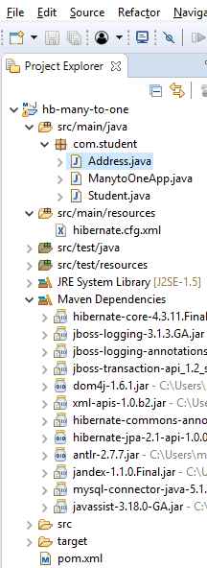
Demo: ManyToOne / OneToMany Mapping ( Bidirectional ) Duration: 15 min
The project structure is as follows and maven dependency as in pom.xml
<project xmlns="http://maven.apache.org/POM/4.0.0" xmlns:xsi="http://www.w3.org/2001/XMLSchema-instance" xsi:schemaLocation="http://maven.apache.org/POM/4.0.0 http://maven.apache.org/xsd/maven-4.0.0.xsd">
<modelVersion>4.0.0</modelVersion>
<groupId>many-to-one</groupId>
<artifactId>hb-many-to-one</artifactId>
<version>0.0.1-SNAPSHOT</version>
<dependencies>
<dependency>
<groupId>org.hibernate</groupId>
<artifactId>hibernate-core</artifactId>
<version>4.3.11.Final</version>
</dependency>
<dependency>
<groupId>mysql</groupId>
<artifactId>mysql-connector-java</artifactId>
<version>5.1.38</version>
</dependency>
<dependency>
<groupId>org.javassist</groupId>
<artifactId>javassist</artifactId>
<version>3.18.0-GA</version>
</dependency>
</dependencies>
</project>

Slide 51
Cont..
Student entity class which will create table in database
Address.java file creating address table with entities
package com.student;
import javax.persistence.Column;
import javax.persistence.Entity;
import javax.persistence.GeneratedValue;
import javax.persistence.Id;
import javax.persistence.Table;
@Entity
@Table(name = "ADDRESS")
public class Address {
private long addressId;
private String street;
private String city;
private String state;
private String zipcode;
public Address() {
}
public Address(String street, String city, String state, String zipcode) {
this.street = street;
this.city = city;
this.state = state;
this.zipcode = zipcode;
}
@Id
@GeneratedValue
@Column(name = "ADDRESS_ID")
public long getAddressId() {
return this.addressId;
}
public void setAddressId(long addressId) {
this.addressId = addressId;
}
@Column(name = "ADDRESS_STREET", nullable = false, length=250)
public String getStreet() {
return this.street;
}
public void setStreet(String street) {
this.street = street;
}
@Column(name = "ADDRESS_CITY", nullable = false, length=50)
public String getCity() {
return this.city;
}
public void setCity(String city) {
this.city = city;
}

Slide 52
Cont..
@Column(name = "ADDRESS_STATE", nullable = false, length=50)
public String getState() {
return this.state;
}
public void setState(String state) {
this.state = state;
}
@Column(name = "ADDRESS_ZIPCODE", nullable = false, length=10)
public String getZipcode() {
return this.zipcode;
}
public void setZipcode(String zipcode) {
this.zipcode = zipcode;
}
}

Slide 53
Cont..
Along with student we get address with cascade all we used in Student.java class
package com.student;
import javax.persistence.CascadeType;
import javax.persistence.Column;
import javax.persistence.Entity;
import javax.persistence.GeneratedValue;
import javax.persistence.Id;
import javax.persistence.ManyToOne;
import javax.persistence.Table;
@Entity
@Table(name = "STUDENT")
public class Student {
private long studentId;
private String studentName;
private Address studentAddress;
public Student() {
}
public Student(String studentName, Address studentAddress) {
this.studentName = studentName;
this.studentAddress = studentAddress;
}
@Id
@GeneratedValue
@Column(name = "STUDENT_ID")
public long getStudentId() {
return this.studentId;
}
public void setStudentId(long studentId) {
this.studentId = studentId;
}
@Column(name = "STUDENT_NAME", nullable = false, length = 100)
public String getStudentName() {
return this.studentName;
}
public void setStudentName(String studentName) {
this.studentName = studentName;
}
@ManyToOne(cascade = CascadeType.ALL)
public Address getStudentAddress() {
return this.studentAddress;
}
public void setStudentAddress(Address studentAddress) {
this.studentAddress = studentAddress;
}
}

Slide 54
Cont..
By using cascade=all options the address which need not be saved explicitly when the student object will get persisted the address will be automatically saved.
MainOneApp
package com.student;
import org.hibernate.Session;
import org.hibernate.SessionFactory;
import org.hibernate.boot.registry.StandardServiceRegistryBuilder;
import org.hibernate.cfg.Configuration;
public class ManytoOneApp {
public static SessionFactory getSessionFactory() {
Configuration configuration = new Configuration().configure();
StandardServiceRegistryBuilder builder = new StandardServiceRegistryBuilder()
.applySettings(configuration.getProperties());
SessionFactory sessionFactory = configuration
.buildSessionFactory(builder.build());
return sessionFactory;
}
public static void main(String[] args) {
// TODO Auto-generated method stub
System.out.println("Hibernate one to one (Annotation)");
Session session = getSessionFactory().openSession();
session.beginTransaction();
Address address1 = new Address("Nehru Road", "Pune", "MH", "400008");
Address address2 =new Address("Neptune City","Delhi","DL","500009");
//session.save(address);
Student student1 = new Student("Sunil", address1);
Student student2 = new Student("Rina", address2);
session.save(student1);
session.save(student2);
session.getTransaction().commit();
System.out.println("Inserting values into tables Student,Address....");
System.out.println("Done");
}}

Slide 55
Cont..
Configuration file to be stored in resources folder for mapping student and address java files to tables
<?xml version='1.0' encoding='UTF-8'?>
<!DOCTYPE hibernate-configuration PUBLIC
"-//Hibernate/Hibernate Configuration DTD 3.0//EN"
"http://www.hibernate.org/dtd/hibernate-configuration-3.0.dtd">
<hibernate-configuration>
<session-factory>
<property name="hibernate.dialect">org.hibernate.dialect.MySQLDialect</property>
<property name="hibernate.connection.driver_class">com.mysql.jdbc.Driver</property>
<property name="hibernate.connection.url">jdbc:mysql://localhost/training</property>
<property name="hibernate.connection.username">root</property>
<property name="hibernate.connection.password">root</property>
<property name="hibernate.hbm2ddl.auto">update</property>
<property name="show_sql">false</property>
<property name="hibernate.current_session_context_class">org.hibernate.context.internal.ThreadLocalSessionContext</property>
<mapping class="com.student.Student"/>
<mapping class="com.student.Address"/>
</session-factory>
</hibernate-configuration>

Slide 56
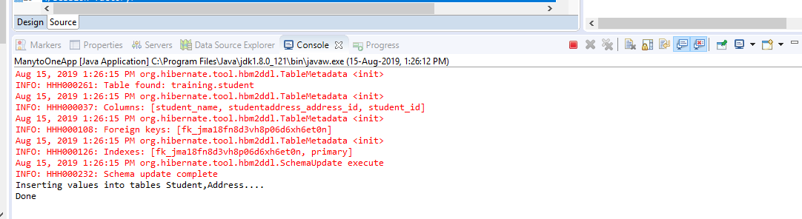
Cont..
After inserting values into Student and Address table the console will display following message

Slide 57
MappedByProperty:
MappedByProperty:
MappedBy gives signal in hibernate for relationship.
It is object of entity of same class created in another class.
In one to one Perform at any side of mapping but perform at only one side . It will remove the extra column of foreign key constraint on the table on which class it is applied.
For example :
If we mapped by property in Employee class on employee object, then foreign key from Employee table will be removed.
You started with ManyToOne mapping , then you put OneToMany mapping as well for BiDirectional way.
Then at OneToMany , you must mention "mappedBy" (mapping is done by and in child table/class)
Notes:
Mapped by can be used only in one class because one table must contain foreign key constraint. if mapped by can be applied on both side then it remove foreign key from both table and without foreign key there is no relation b/w two tables.
it can be use for following annotations:- 1.@OneTone 2.@OneToMany 3.@ManyToMany
It cannot be use for following annotation :- 1.@ManyToOne

Slide 58
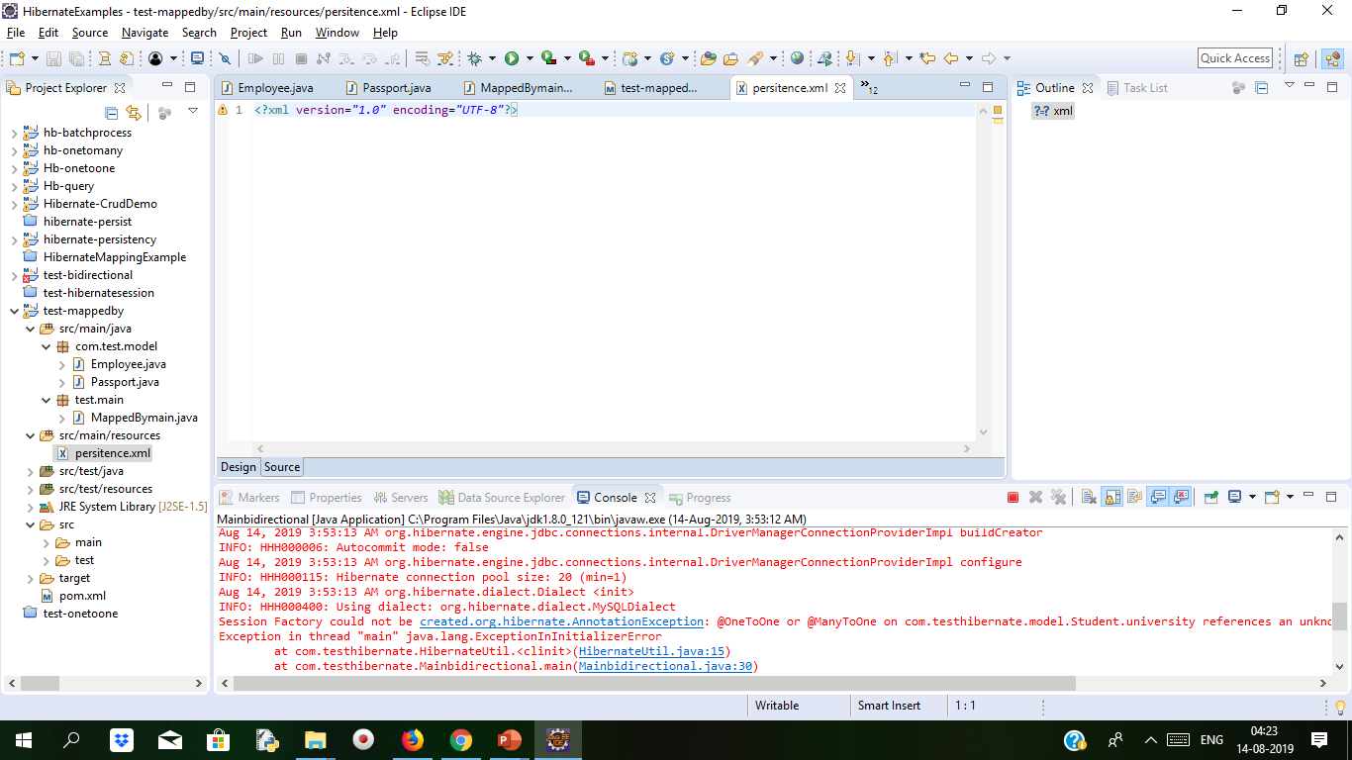
Demo: Mapping Duration 10min
Step 1:
Create Project With Suitable Name

Slide 59
Cont..
Step 2:
Add Dependency in POM.XML file
<dependencies>
<!-- https://mvnrepository.com/artifact/org.eclipse.persistence/eclipselink -->
<dependency>
<groupId>org.eclipse.persistence</groupId>
<artifactId>eclipselink</artifactId>
<version>2.5.2</version>
</dependency>
<dependency>
<groupId>org.eclipse.persistence</groupId>
<artifactId>javax.persistence</artifactId>
<version>2.0.0</version>
</dependency>
<!-- https://mvnrepository.com/artifact/mysql/mysql-connector-java -->
<dependency>
<groupId>mysql</groupId>
<artifactId>mysql-connector-java</artifactId>
<version>5.1.40</version>
</dependency>
<!-- https://mvnrepository.com/artifact/org.hibernate/hibernate-core -->
<dependency>
<groupId>org.hibernate</groupId>
<artifactId>hibernate-core</artifactId>
<version>5.2.11.Final</version>
</dependency>
<dependency>
<groupId>org.hibernate</groupId>
<artifactId>hibernate-entitymanager</artifactId>
<version>5.2.11.Final</version>
</dependency>
</dependencies>
<build>
<finalName>${project.artifactId}</finalName>
</build>
</project>

Slide 60
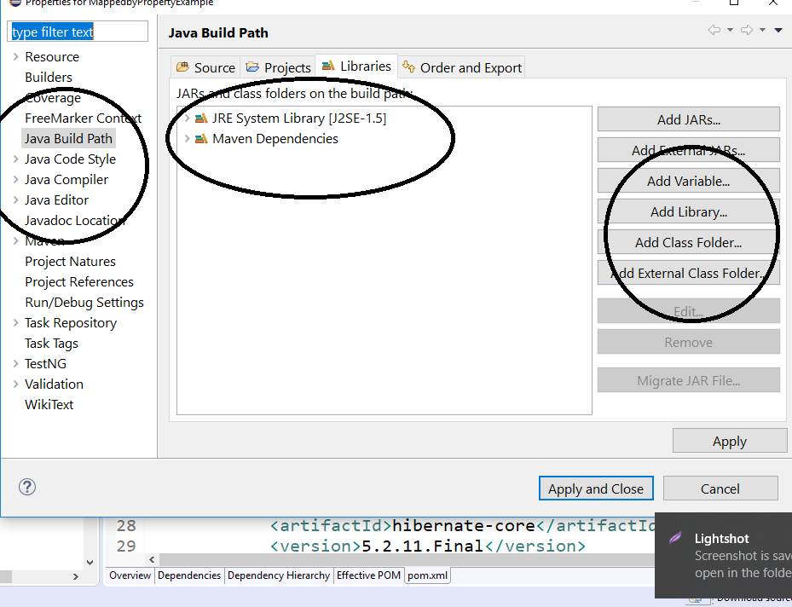
Cont..
Step 3:
Add User Library from build path

Slide 61
Cont..
Step 4:
Create Database,tables in MySQL
DROP DATABASE IF EXISTS mapping;
CREATE DATABASE IF NOT EXISTS mapping;
USE mapping;
CREATE TABLE EMPLOYEE_TABLE(
EMP_ID INT NOT NULL auto_increment,
EMP_NAME VARCHAR(50) NOT NULL,
PASSPORT_NUMBER INT NOT NULL,
PRIMARY KEY (EMP_ID)
);
CREATE TABLE PASSPORT_TABLE(
PASSPORT_NUMBER INT NOT NULL auto_increment,
ADDRESS_LINE1 VARCHAR(100) NOT NULL,
ADDRESS_LINE2 VARCHAR(100) NOT NULL,
STATE_NAME VARCHAR(50) NOT NULL,
COUNTRY_NAME VARCHAR(50) NOT NULL,
PRIMARY KEY (PASSPORT_NUMBER)
);

Slide 62
Cont..
@OneToOne(fetch = FetchType.LAZY, cascade = CascadeType.ALL)
@JoinColumn(name = "PASSPORT_NUMBER")
private Passport passportDetails;
public Employee() { }
public int getEmployeeId() {
return employeeId;
}
public void setEmployeeId(int employeeId) {
this.employeeId = employeeId;
}
public String getName() {
return name;
}
public void setName(String name) {
this.name = name;
}
public Passport getPassportDetails() {
return passportDetails;
}
public void setPassportDetails(Passport passportDetails) {
this.passportDetails = passportDetails;
}
}
Package test.model;
import java.io.Serializable;
import javax.persistence.CascadeType;
import javax.persistence.Column;
import javax.persistence.Entity;
import javax.persistence.FetchType;
import javax.persistence.GeneratedValue;
import javax.persistence.GenerationType;
import javax.persistence.Id;
import javax.persistence.JoinColumn;
import javax.persistence.OneToOne;
import javax.persistence.Table;
@Entity
@Table(name = "EMPLOYEE_TABLE")
public class Employee implements Serializable {
private static final long serialVersionUID = 1L;
@Id
@Column(name = "EMP_ID")
@GeneratedValue(strategy = GenerationType.IDENTITY)
private int employeeId;
@Column(name = "EMP_NAME")
private String name;

Slide 63
Cont..
Package test.model;
import java.io.Serializable;
import javax.persistence.Column;
import javax.persistence.Entity;
import javax.persistence.GeneratedValue;
import javax.persistence.GenerationType;
import javax.persistence.Id;
import javax.persistence.Table;
@Entity
@Table(name = "PASSPORT_TABLE")
public class Passport implements Serializable {
private static final long serialVersionUID = 1L;
@Id
@Column(name = "PASSPORT_NUMBER")
@GeneratedValue(strategy = GenerationType.IDENTITY)
private int passportNumber;
@Column(name = "ADDRESS_LINE1")
private String addressLine1;
@Column(name = "ADDRESS_LINE2")
private String addressLine2;
@Column(name = "STATE_NAME")
private String state;
@Column(name = "COUNTRY_NAME")
private String country;
public Passport() { }
public int getPassportNumber() {
return passportNumber;
}
public void setPassportNumber(int passportNumber) {
this.passportNumber = passportNumber;
}
public String getAddressLine1() {
return addressLine1;
}
public void setAddressLine1(String addressLine1) {
this.addressLine1 = addressLine1;
}
public String getAddressLine2() {
return addressLine2;
}
public void setAddressLine2(String addressLine2) {
this.addressLine2 = addressLine2;
}
public String getState() {
return state;
}
public void setState(String state) {
this.state = state;
}
public String getCountry() {
return country;
}
public void setCountry(String country) {
this.country = country;
}
}

Slide 64
Cont..
Now Configure in Persistance.xml file instead of Hbm.Confg.xml file
Persistance.XML file define one or more object-relation. Keep this file in resources folder
<?xml version="1.0" encoding="UTF-8"?>
<persistence version="2.1"
xmlns="http://xmlns.jcp.org/xml/ns/persistence" xmlns:xsi="http://www.w3.org/2001/XMLSchema-instance"
xsi:schemaLocation="http://xmlns.jcp.org/xml/ns/persistence http://xmlns.jcp.org/xml/ns/persistence/persistence_2_1.xsd">
<persistence-unit name=" mappedby " transaction-type="RESOURCE_LOCAL">
<class>com.test.model.Employee</class>
<class> com.test.model.Passport</class>
<!-- Configuring The Database Connection Details -->
<properties>
<property name="javax.persistence.jdbc.driver" value="com.mysql.jdbc.Driver" />
<property name="javax.persistence.jdbc.url" value="jdbc:mysql://localhost:3306/mapping" />
<property name="javax.persistence.jdbc.user" value="root" />
<property name="javax.persistence.jdbc.password" value=“root" />
</properties>
</persistence-unit>
</persistence>

Slide 65
Cont..
Main java file will map with persistence.xml file for configuration
import javax.persistence.EntityManager;
import javax.persistence.EntityManagerFactory;
import javax.persistence.Persistence;
public class MainApp {
private static final EntityManagerFactory emFactoryObj;
private static final String PERSISTENCE_UNIT_NAME = " mappedby ";
static {
emFactoryObj = Persistence.createEntityManagerFactory(PERSISTENCE_UNIT_NAME);
}
// This Method Is Used To Retrieve The 'EntityManager' Object
public static EntityManager getEntityManager() {
return emFactoryObj.createEntityManager();
}
private static void insertRecord() {
EntityManager entityMgrObj = getEntityManager();
if (null != entityMgrObj) {
entityMgrObj.getTransaction().begin();
Employee empObj = new Employee();
empObj.setName("Harry Potter");
Passport passportDetailsObj = new Passport();
passportDetailsObj.setAddressLine1("Cupboard Under D' Stairs");
passportDetailsObj.setAddressLine2(" 4 Privet Drive");
passportDetailsObj.setState("Little Whinging");
passportDetailsObj.setCountry("Surrey");
empObj.setPassportDetails(passportDetailsObj);
entityMgrObj.persist(empObj);
entityMgrObj.getTransaction().commit();
entityMgrObj.clear();
System.out.println("Record Successfully Inserted In The Database");
}
}
public static void main(String[] args) {
insertRecord();
}
}

Slide 66
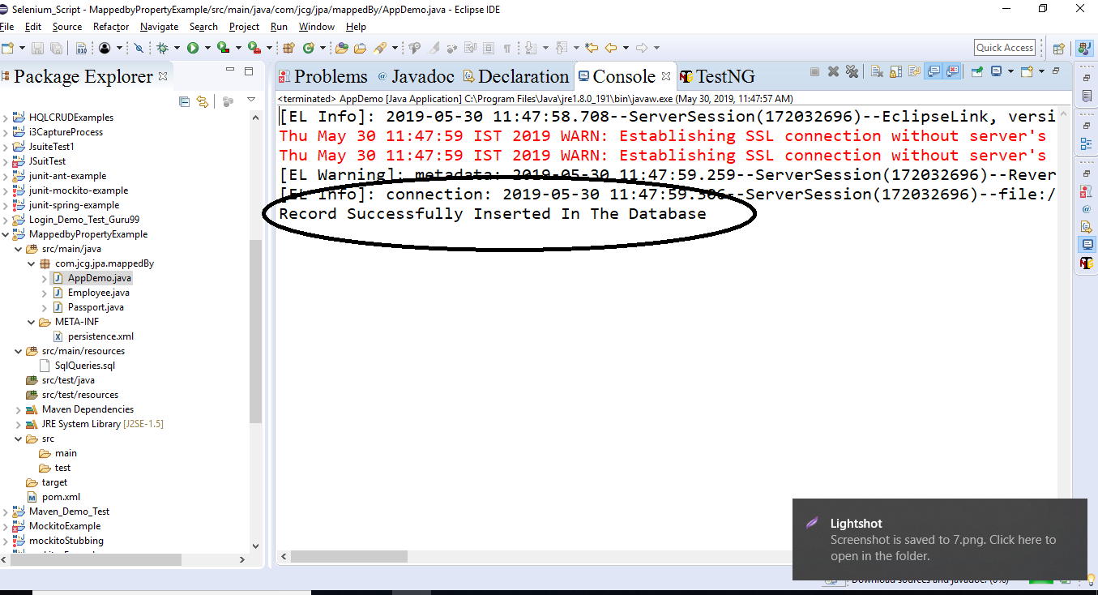
Cont..
Run The program

Slide 67
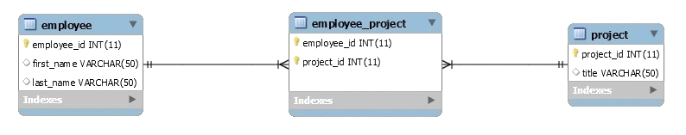
Many to Many Mapping
Many-TO-MANY mapping use the SET concept of collection.
A SET is mapped table data in <SET>
Employee can be assigned multiple to multiple projects and multiple employees.
It is implemented for database using JOIN table.
It is defined as multiple entities where one can have multiple relations.
One thing is important here is that when we used MANY-TO-MANY mapping in Hibernate it will generate two POJO objects

Slide 68
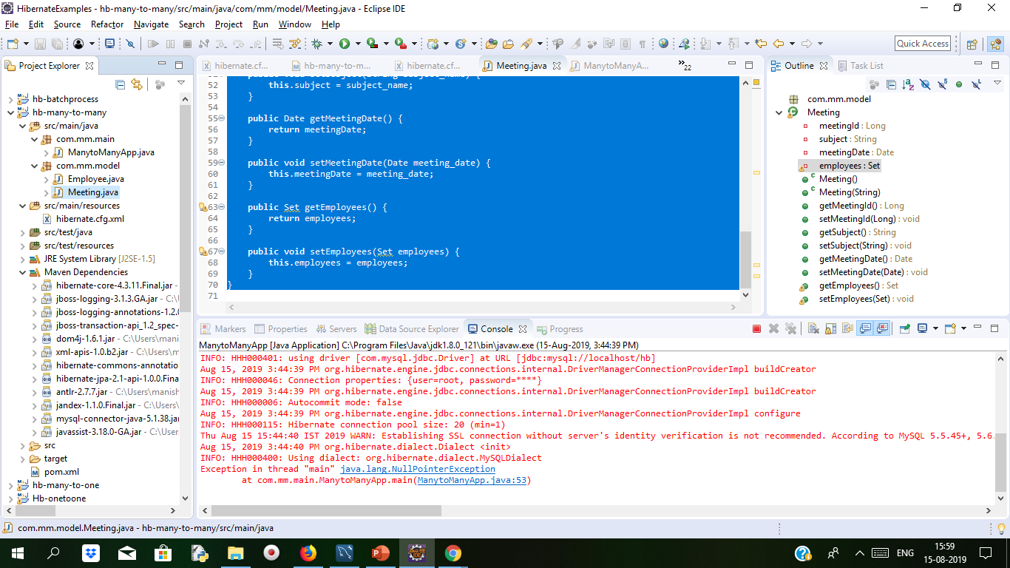
Demo: Many to Many mapping Duration: 15 min
Create Project With Suitable Name

Slide 69
Demo: Many to Many mapping Cont..
Add dependency in POM.XML
<dependencies>
<!-- Hibernate 4.3.6 Final -->
<dependency>
<groupId>org.hibernate</groupId>
<artifactId>hibernate-core</artifactId>
<version>4.3.6.Final</version>
</dependency>
<!-- Mysql Connector -->
<dependency>
<groupId>mysql</groupId>
<artifactId>mysql-connector-java</artifactId>
<version>5.1.21</version>
</dependency>
</dependencies>
<build>
<finalName>${project.artifactId}</finalName>
</build>
</project>

Slide 70
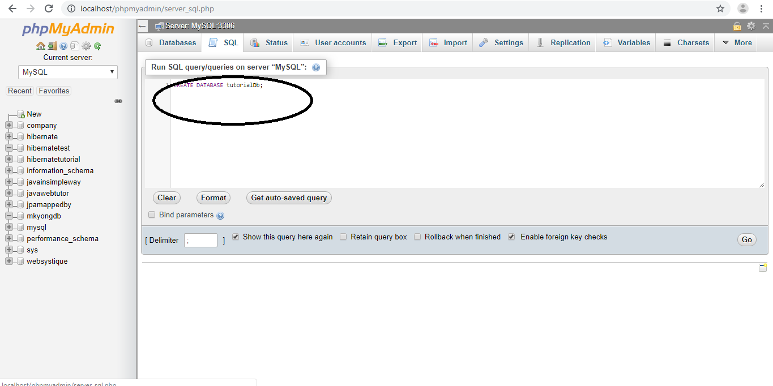
Demo: Many to Many mapping Cont..
Create Databse

Slide 71
Demo: Many to Many mapping Cont..
Create Suitable Table
CREATE TABLE employee (
employee_id int(10) NOT NULL AUTO_INCREMENT,
firstname VARCHAR(50) NULL DEFAULT NULL,
lastname VARCHAR(50) NULL DEFAULT NULL,
PRIMARY KEY (employee_id)
);
CREATE TABLE meeting (
meeting_id int(20) NOT NULL AUTO_INCREMENT,
subject VARCHAR(50) NOT NULL,
meeting_date DATE NOT NULL,
PRIMARY KEY (meeting_id)
);
CREATE TABLE employee_meeting (
employee_id int(20) NOT NULL,
meeting_id int(20) NOT NULL,
PRIMARY KEY (employee_id, meeting_id),
INDEX FK_MEETING (meeting_id),
CONSTRAINT FK_EMPLOYEE FOREIGN KEY (employee_id) REFERENCES employee (employee_id),
CONSTRAINT FK_MEETING FOREIGN KEY (meeting_id) REFERENCES meeting (meeting_id)
);

Slide 72
Demo: Many to Many mapping Cont..
Configure hibernate.cfg.XML file and give database name
<?xml version='1.0' encoding='UTF-8'?>
<!DOCTYPE hibernate-configuration PUBLIC
"-//Hibernate/Hibernate Configuration DTD 3.0//EN"
"http://www.hibernate.org/dtd/hibernate-configuration-3.0.dtd">
<hibernate-configuration>
<session-factory>
<property name="hibernate.dialect">org.hibernate.dialect.MySQLDialect</property>
<property name="hibernate.connection.driver_class">com.mysql.jdbc.Driver</property>
<property name="hibernate.connection.url">jdbc:mysql://localhost/hb</property>
<property name="hibernate.connection.username">root</property>
<property name="hibernate.connection.password">root</property>
<property name="hibernate.hbm2ddl.auto">update</property>
<property name="show_sql">false</property>
<property name="hibernate.current_session_context_class">org.hibernate.context.internal.ThreadLocalSessionContext</property>
<mapping class="com.mm.model.Employee"/>
<mapping class="com.mm.model.Meeting"/>
</session-factory>
</hibernate-configuration>

Slide 73
Demo: Many to Many mapping Cont..
Create Employee class with @ManytoMany annotation
import java.util.HashSet;
import java.util.Set;
import javax.persistence.CascadeType;
import javax.persistence.Column;
import javax.persistence.Entity;
import javax.persistence.GeneratedValue;
import javax.persistence.Id;
import javax.persistence.JoinColumn;
import javax.persistence.JoinTable;
import javax.persistence.ManyToMany;
import javax.persistence.Table;
@Entity
@Table(name="employee")
public class Employee {
@Id
@Column(name="employee_id")
@GeneratedValue
private Long employeeId;
@Column(name="firstname")
private String firstname;
@Column(name="lastname")
private String lastname;
@ManyToMany(cascade = {CascadeType.ALL})
@JoinTable(name="employee_meeting", joinColumns= {@JoinColumn(name="employee_id")}, inverseJoinColumns= {@JoinColumn(name="meeting_id")})
private Set meetings = new HashSet();
public Employee() { }
public Employee(String first_name, String last_name) {
this.firstname = first_name;
this.lastname = last_name;
}
public Long getEmployeeId() {
return employeeId;
}
public void setEmployeeId(Long employee_id) {
this.employeeId = employee_id;
}
public String getFirstname() {
return firstname;
}

Slide 74
Demo: Many to Many mapping Cont..
Create Employee class with @ManytoMany annotation
Meeting.java
package com.mm.model;
import java.util.Date;
import java.util.HashSet;
import java.util.Set;
import javax.persistence.Column;
import javax.persistence.Entity;
import javax.persistence.GeneratedValue;
import javax.persistence.Id;
import javax.persistence.ManyToMany;
import javax.persistence.Table;
@Entity
@Table(name="meeting")
public class Meeting {
@Id
@Column(name="meeting_id")
@GeneratedValue
private Long meetingId;
@Column(name="subject")
private String subject;
@Column(name="meeting_date")
private Date meetingDate;
public void setFirstname(String first_name) {
this.firstname = first_name;
}
public String getLastname() {
return lastname;
}
public void setLastname(String last_name) {
this.lastname = last_name;
}
public Set getMeetings() {
return meetings;
}
public void setMeetings(Set meetings) {
this.meetings = meetings;
}
}

Slide 75
Demo: Many to Many mapping Cont..
Create Employee class with @ManytoMany annotation
@ManyToMany(mappedBy="meetings")
private Set employees = new HashSet();
public Meeting() { }
public Meeting(String subject) {
this.subject = subject;
this.meetingDate = new Date();
}
public Long getMeetingId() {
return meetingId;
}
public void setMeetingId(Long meeting_id) {
this.meetingId = meeting_id;
}
public String getSubject() {
return subject;
}
public void setSubject(String subject_name) {
this.subject = subject_name;
}
public Date getMeetingDate() {
return meetingDate;
}
public void setMeetingDate(Date meeting_date) {
this.meetingDate = meeting_date;
}
public Set getEmployees() {
return employees;
}
public void setEmployees(Set employees) {
this.employees = employees;
}
}

Slide 76
Demo: Many to Many mapping Cont..
Create Main Java class
package com.mm.main;
import org.hibernate.Session;
import org.hibernate.SessionFactory;
import org.hibernate.boot.registry.StandardServiceRegistryBuilder;
import org.hibernate.cfg.Configuration;
import org.hibernate.service.ServiceRegistry;
import com.mm.model.Employee;
import com.mm.model.Meeting;
public class ManytoManyApp {
static Session sessionObj;
static SessionFactory sessionFactoryObj;
public static SessionFactory getSessionFactory() {
Configuration configuration = new Configuration().configure();
StandardServiceRegistryBuilder builder = new StandardServiceRegistryBuilder()
.applySettings(configuration.getProperties());
SessionFactory sessionFactory = configuration
.buildSessionFactory(builder.build());
return sessionFactory;
}
public static void main(String[] args) {
try {
Session session = getSessionFactory().openSession();
session.beginTransaction();
Meeting quaterlyMeet = new Meeting("Quearterly sales Meeting");
Meeting weeklyMeet = new Meeting("Weekly sales Meeting");
Meeting dailyMeet = new Meeting("Daily sales Meeting");
Employee empObj1 = new Employee("Dhruv", "Joshi");
empObj1.getMeetings().add(quaterlyMeet);
empObj1.getMeetings().add(weeklyMeet);
sessionObj.save(empObj1);
Employee empObj2 = new Employee("Danny", "Leo");
empObj2.getMeetings().add(quaterlyMeet);
sessionObj.save(empObj2);
Employee empObj3 = new Employee("Zuber'", "Khan");
empObj3.getMeetings().add(weeklyMeet);
empObj3.getMeetings().add(dailyMeet);
sessionObj.save(empObj3);
// Committing The Transactions To The Database
sessionObj.getTransaction().commit();
System.out.println("\n.......Records Saved Successfully To The Database.......");
} catch(Exception sqlException) {
if(null != sessionObj.getTransaction()) {

Slide 77
Demo: Many to Many mapping Cont..
System.out.println("\n.......Transaction Is Being Rolled Back.......");
sessionObj.getTransaction().rollback();
}
sqlException.printStackTrace();
} finally {
if(sessionObj != null) {
sessionObj.close();
}
}
}
}

Slide 78
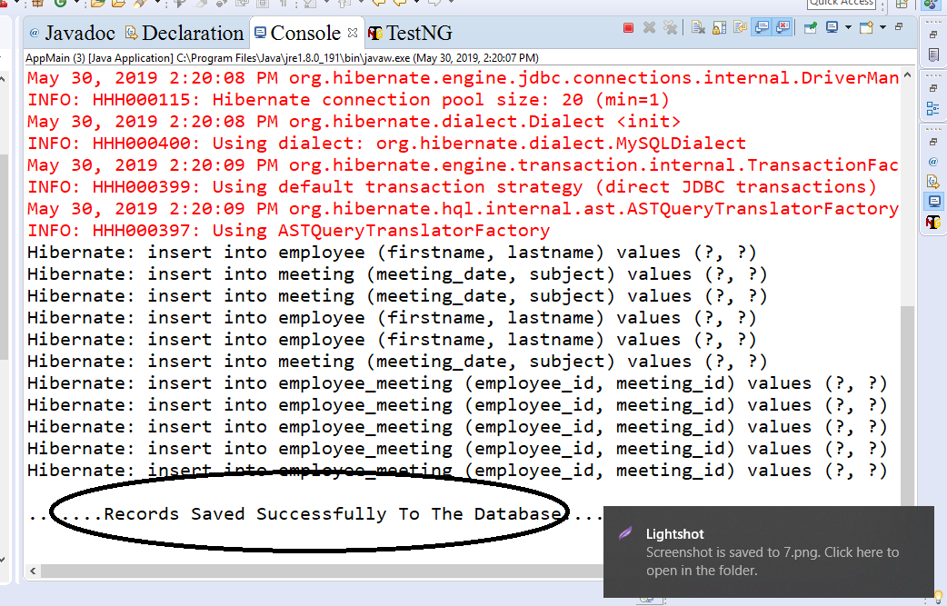
Demo: Many to Many mapping Cont..
Step 8:
Run the program After running main app the table values got inserted into the tables

Slide 79
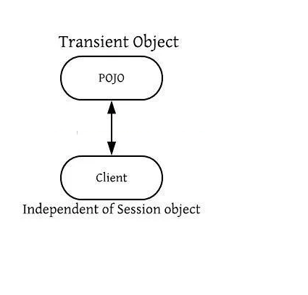
Hibernate Object State
It play important role in the execution of code in java.
It is also called life cycle of Hibernate.
It has three state:
1.Transient Object State
2.Persistent Object State
3.Detached Object State
1.Transient Object State

Slide 80
Hibernate Object State Cont..
An object which is not defined with session is called Transient Object State.
No Any Row defined in database is Transient Object State
It is Garbage Collector No Other Object Refer To It.
It is created with new() Operator.
When Object defined in Transient Object State there is no defined any identifier.
Example:
Customer cst = new Customer();
cst.setName(“Daniel Diaz");
// the object cst is in a transient state

Slide 81
OIR Mappings
So far, we learned about how to write our first hibernate application, there are two approach we have used for that
Using Annotation for Model Class Object Mapping
Another way Using Hibernate O/R Mapping file(.hbm.xml) for Model Class Object Mapping.
<?xml version=”1.0″?> <!DOCTYPE hibernate-mapping PUBLIC “-//Hibernate/Hibernate Mapping DTD 3.0//EN” “http://hibernate.sourceforge.net/hibernate-mapping-3.0.dtd”>
<hibernate-mapping> <class name=”com.test.hibernate.model.UserDetails” table=”UserDetails”> <id name=”userId” type=”long” column=”ID” > <generator class=”assigned”/> </id>
<property name=”userName”> <column name=”UserName” /> </property> </class> </hibernate-mapping>

Slide 82
Summary
In this Module, we have learnt the following:
What is Mapping
Persistent Class
Mapping Files
Mapping Types
OIR Mappings

Slide 83

Thank You

